Slide 1
Life Transitions: Easing Into Parenthood
Team: #7
Team Name: The Seven
Team Members: Mehroos Ali, Soumadeep Basu, Mary Grace Kozuch, Sudarshan Athreya Suresh

Slide 2
Introduction: Team
Mehroos Ali is a final year masters student specializing in Intelligent Systems. A software engineer professional with expertise spanning in data engineering, backend development and cloud computing.
Soumadeep Basu is a final year masters student specializing in Data Science.
Mary Grace Kozuch is a second year PhD student focusing on data bias reduction and data privacy. She has experience in cybersecurity training methodologies, DevSecOps pipeline creation, and user data analysis.
Sudarshan Athreya Suresh is a final year Masters student studying Data Science with an emphasis on language processing.

Slide 3
Introduction: Project
Problem Domain: Assisting individuals in their transition into parenthood
User Experience: We aim to ease the transition into parenthood for individuals with babies and young children. The user will have access to some variation of tools such as helpful information, recommendations, chat rooms, activity tracking tools, shops, events near them and/or others. The goal is to provide a simple, easy to use, product to assist a parent in many potential areas they need help with on a daily basis.

Slide 4
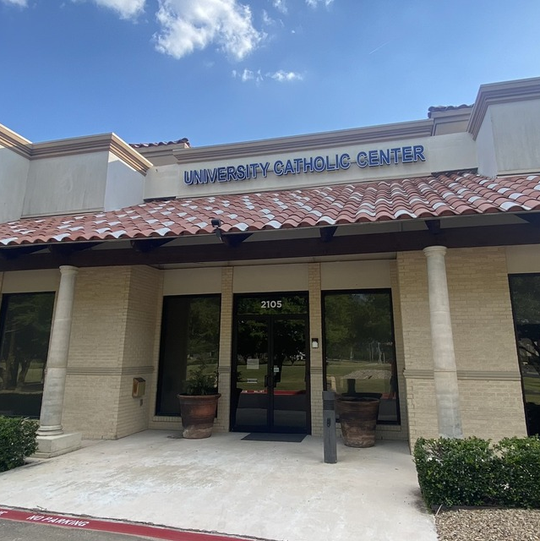
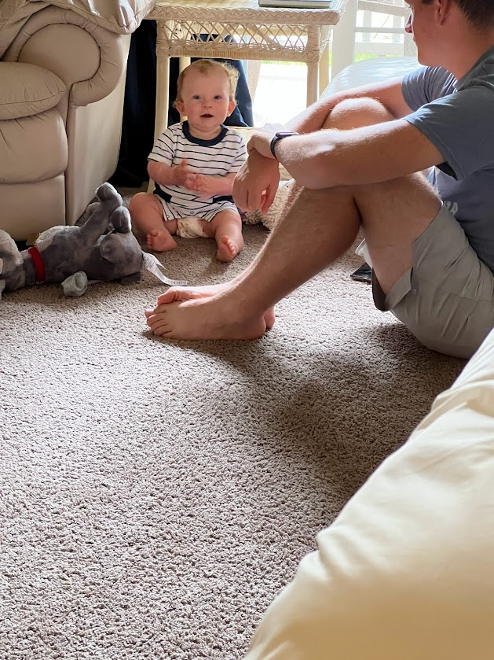
Needfinding Methodology: Participants
Interviewee 1: A mother in her late-20’s who works part-time with one child who is 4 months old. She is a campus missionary chosen due to her proximity to campus and availability for interview at the University Catholic Center near UTD.
Interviewee 2: A mother in her mid-20’s who works part-time with a 1 year old son. She was previously known to the team members and willing to speak about her experience as a mother. Her experience as the main child care parent while working part-time made her uniquely knowledgeable on both motherhood and working with a child. She was interviewed at her home without her child present.
Interviewee 3: A father in his mid-20’s who works full-time from home with one child who is 1 year old. He was chosen due to his familial relationship with a team member and availability. He was interviewed at his home with his wife and son present.

Slide 5
Needfinding Methodology: Questions
How are you?
What does a day look like to you?
How has your day changed from before you were a parent to now?
Do you have a traditional job? If so, did it change when you became a parent?
What are your biggest concerns and stressors that you have now and how are they different to before you had a child?
What are your personal needs now, both physical and mental, and how have they changed since becoming a parent?
Whats is the best piece of advice you got when you became a new parent?
What was your first real parent moment?
What do you wish you knew in your first year as parents?
What advice do you have to people becoming new parents or thinking about becoming a parent?

Slide 6
Needfinding Methodology: Interview
The team came up with a list locations on and near the UTD campus where we can find new parents. These locations included nearby churches, day care centers, medical centers and children parks.
After meeting with the interviewees in person and confirming their participation to our project, we came up with a list of questions to ask.
We gave the interviewees flexible meeting times to accommodate their children’s sleep and eating schedules. As well as meeting at child friendly locations to allow the parents to continue their childcare while being interviewed.
Our team was in constant touch with the interviewees addressing any query or concerns they had regarding the interview.
The lead interviewer was Mary Grace. The rest of the team alternated roles in order to support the interviewing and analysis process.
All the 3 interviews were conducted within 2 days and each interview lasted between 20 to 40 minutes. The interviews were also sound recorded for our analysis with the permission from the interviewees.
After the interview, we thanked the participants for their time and giving us valuable information for our project. We intend to follow up with them if we have any future questions and constantly keep them aware with our project progress.

Slide 7
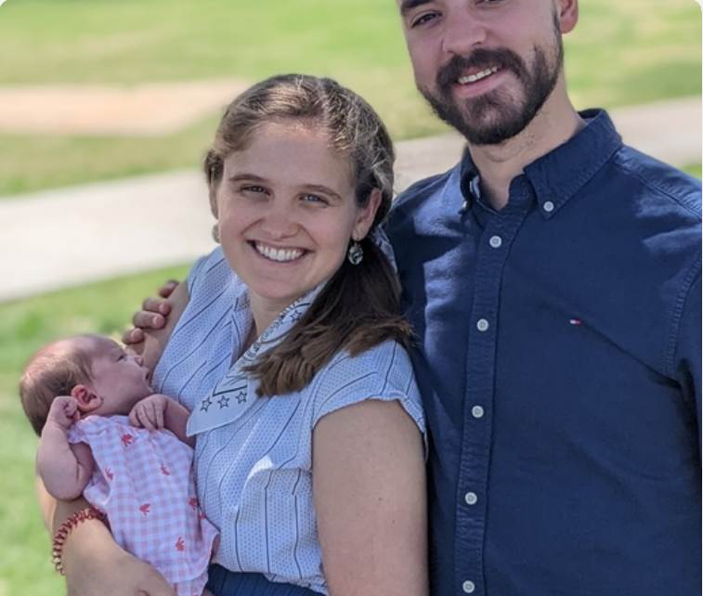
Interview Results: Interviewee 1
We spoke with a mother in her late 20’s to a 4-month old daughter. The mother works part time as a Fellowship of Catholic University Students (FOCUS) mentor at the University of Texas Dallas.
Throughout the interview she was consistently engaged with her daughter whom she had brought with her and was entertaining with a small rubber teething toy. While attempting to soothe her daughter, the mother spoke of her experiences caring for her daughter, her husband, and herself. She specifically focused on her difficulties with her daughter’s sleep schedule and her own troubles getting enough sleep while caring for her daughter. She additionally spoke of her efforts to continue to foster a healthy relationship with her husband while adapting to her new role as a mother which required her to move to a part-time position where she had previously worked full time alongside her spouse.
Team Members Present: Mehroos Ali, Soumadeep Basu, Mary Grace Kozuch

Slide 8
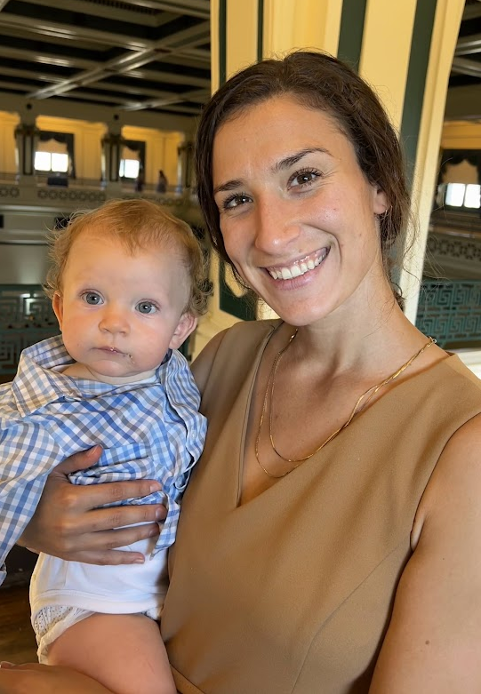
Interview Results: Interviewee 2
We spoke with a 25 year old mother with a 1 year old son. She works part time as an occupational therapist at an elementary school.
Her husband was watching their son while she spoke so she was able to focus on the interview. She became visibly upset during the latter part of the interview most likely due to stress, sleep deprivation, and frustration at the many emotions discovered through caring for a child. She discussed the desire to find the most up to date information to assist with her child’s sleep and the hardships of working part-time out of the home while being the main caretaker for her child.
Team Members Present: Mehroos Ali, Soumadeep Basu, Mary Grace Kozuch

Slide 9
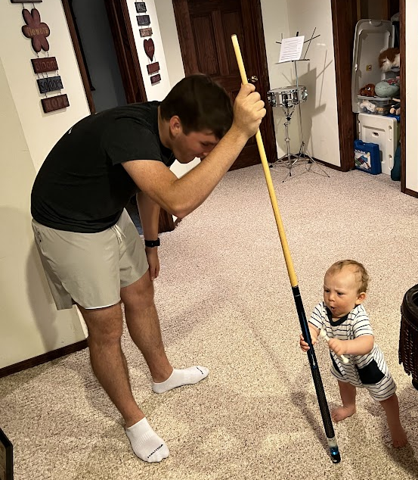
Interview Results: Interviewee 3
We interviewed a 25 year old father to a 1 year old son. He works as a Biomedical engineer remotely allowing him to be with his son all day long.
During the interview he was passing his child back and forth with his wife and was distracted by the need to feed and bathe his son. He spoke of his desire to meet other parents his age in the area to speak, with as well as finding other children his son’s age for his son to interact with. He repeatedly asked his wife about the interview questions showing that he simply responds to the child's needs as he feels is best.
Team Members Present: Soumadeep Basu, Mary Grace Kozuch, Sudarshan Athreya Suresh

Slide 10
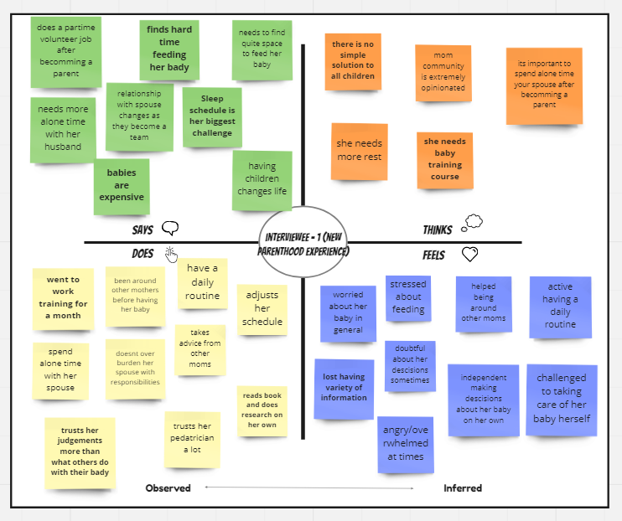
Analysis - Empathy Map (most interesting interview)

Slide 11
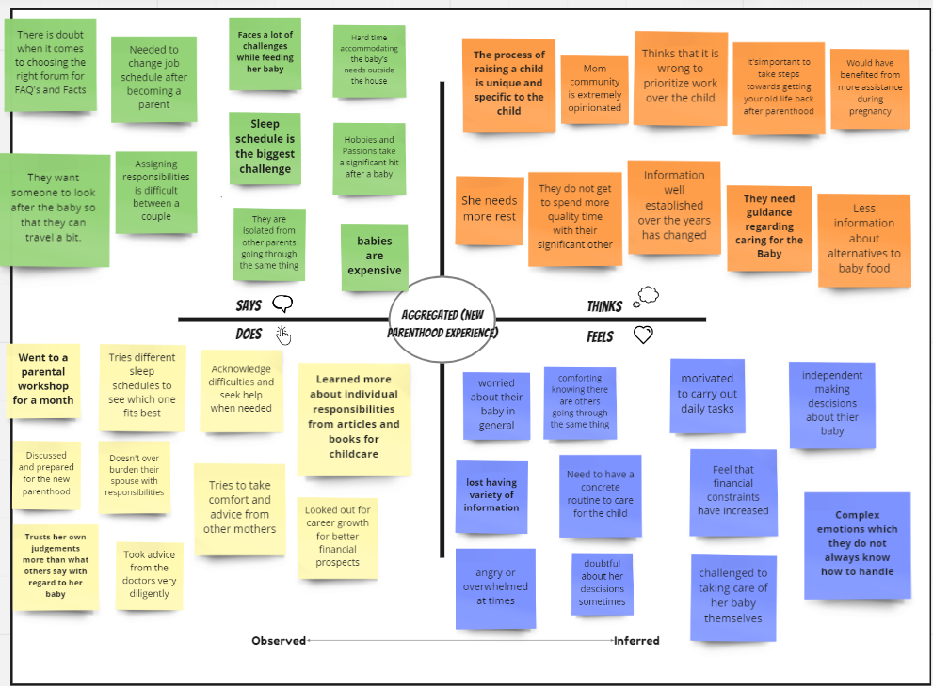
Analysis - Empathy Map (aggregated interviews)

Slide 12
Analysis - tensions, surprises, contradictions
Even though babies have not changed, most things that are advised as healthy for babies are different from the previous generations.
Lots of people advise that a caretaker should sleep when the baby sleeps but it is almost impossible to sleep on demand and consistently throughout the day as a baby does.
A lot of the advice on how to help a baby sleep safely such as sleeping on a hard mattress are very uncomfortable for the child and make keeping a child asleep very difficult for the parent.
All babies react differently to their surroundings making lots of books inaccurate for a specific baby.
There are a lot of products available for babies but very little readily available information about products as rated by doctors or professionals.
Although many parents share the job of parenting their children, it is difficult for fathers to be as connected or involved as the mother due to their inability to breastfeed the kids.
A large portion of the population has children and it is a well known fact that they are expensive to raise, however, there is not easily available information on how to best save for these expenses.
There is a societal push for mothers to work however, it is also seen as not caring for the child as well if the mother leaves the child with a babysitter or relative to attend their job.
Having a child was seen as a wonderful thing that none of the interviewees would give up but they also stated that they lost sleep, exercise, and their own personal hobbies for their child.
One mother felt guilty leaving her child to leave for work but also felt guilty ‘gatekeeping’ her child from new experiences by always being around.

Slide 13
Analysis - needs (wonder if it means … )
Availability of quiet spaces/rooms/surroundings to feed and change babies.
Planner/Scheduler to track the baby’s daily activity and health.
Someone to look after the baby incase the parents need to go out.
Updated/Aggregated health and well being information about babies.
Help with financial planning.
Recipes for nutritious alternatives to baby food.
Resources to help parents cope with the change in lifestyle.
Outreach so that parents can socialize with people of similar background.
Programs to rehabilitate parents to pursue their independent goals ( both professional and personal )
Collection of stories and videos to keep children entertained.

Slide 14
Analysis - Insights ( It would be game changing to …. )
Design an interface that alerts parents for suitable changing and feeding stations based on location.
Extend above interface to play songs and display images to keep the baby entertained and also get them to sleep easily by creating a calm environment
Create a scheduling application that allows parents to track their baby’s health and daily routine potentially with smart watch interface for ease of use.
Provide all validated and factual baby information ( about well being, allergies, alarming symptoms, FAQ’s etc) at one place.
Platform to enable parents to socialize and learn from more experienced individuals.
Help parents make better financial plans which are designed based on their own goals.
Provide notifications and avenues for parents to get back in tune with their own hobbies and self interests.
Forum to connect parents to secondary care providers in case they have to go out
An application meant to help parents better manage their mental health due to the taxing nature of parenthood
Connect parents with pediatric telehealth channels to help them through emergencies

Slide 15
Summary
As a part of DP1, our team was able to identify a problem space faced by some user population far from us.
From the user population we selected 3 target users and conducted needfinding interviews with them to gain empathy and understand their needs.
For each participant, we unpacked the interview results into an aggregated empathy map and identified surprises (surprises, tensions, & contradictions), needs and insights.
We still question the aggregate interview results as all of the interviewees stated that from their experience there is no one solution to all children’s sleeping, eating, or behavior difficulties and therefore a larger interview set may be necessary for proper analysis of the population.
Our initial assessment from the 3 interviews has given us a good set of needs and insights to work with. The future iterations will:
Expand the interview pool to get a more varied input.
Try to access parents from specific areas such as single parents, parents of a particular culture etc. to get more specific details which can be incorporated.
Take feedback from the interviewees in the further iterations of the project to make sure the vision is in tune with their expectations.

